Slide 1
Data Analysis in Python. Seminar 1: Introduction
Faculty of World Economy and International Affairs
Bachelor’s programme 'HSE and University of London Parallel Degree Programme in International Relations'
Moscow
2022
Lecturer: Ioann Dovgopoliy (Иоанн Довгополый)

Slide 2
Google-survey: we need to become acquainted with each other
Faculty of World Economy and International Affairs
Bachelor’s programme 'HSE and University of London Parallel Degree Programme in International Relations'
Data Analysis in Python. Seminar 1: Introduction
https://docs.google.com/forms/d/e/1FAIpQLScFtWbdpcupd6RrJZsrHBo9fUx6Ni99b_2xRY0uHP9txYQpUQ/viewform?usp=sf_link

Slide 3

About instructors
Faculty of World Economy and International Affairs
Bachelor’s programme 'HSE and University of London Parallel Degree Programme in International Relations'
Data Analysis in Python. Seminar 1: Introduction
my name is Ioann Dovgopoliy (Иоанн Довгополый). Please, call me Ioann;
Bachelor degree in Political Science (HSE, Faculty of Social Science) + Intellectual Data Analysis minor (aka ИАД);
1-st year student of Master’s Programme 'Data Analysis in Biology and Medicine’ (HSE, Faculty of Computer Science);
Development Engineer in a bank;
Visiting Lecturer in HSE;
Feel free to contact me through e-mail (idovgopolyj@hse.ru), Telegram (@TriariiMisha) or VK (https://vk.com/dereinzigemitdemeigentum)
We have an assistant Igor Kolesnikov, you should contact him via Telegram: @makebochkagreatagain

Slide 4
Course outline (also can be found in Syllabus): curriculum
Faculty of World Economy and International Affairs
Bachelor’s programme 'HSE and University of London Parallel Degree Programme in International Relations'
Data Analysis in Python. Seminar 1: Introduction
16 seminars in total:
1st seminar – introduction
9th seminar – midterm
16th seminar – final project’s presentation
1st-8th – Python part, 10th-15th – Data Analysis part

Slide 5
Course outline: grading
Faculty of World Economy and International Affairs
Bachelor’s programme 'HSE and University of London Parallel Degree Programme in International Relations'
Data Analysis in Python. Seminar 1: Introduction
6 Home Assignments (week 2, 4, 6, 10, 12, 14) - 25%
Grade for the HA can be changed if different compared to the grade for the Problem Set (checks whether the related HA was done independently)
Bonus - completing tasks on DataCamp
Quizzes (each week except 9 and 16) - 15%
5 min test at the beginning of a seminar. Problem Set can be randomly assigned instead of a quiz
Midterm (week 9) - 25%
In-class lab - 7-10 problems sets (including bonus tasks), 120 min (content of the weeks 1-8)
Final project - 35%
Group research project on the topic within IR (or social sciences) with application of the data analysis tools
Final Grade = 0.25 * mean(Home Assignments and Problem Sets) + 0.15 * mean(Quizzes) + 0.25 * Midterm + 0.35 * Final Project + Bonus

Slide 6

Course outline: important notes
Faculty of World Economy and International Affairs
Bachelor’s programme 'HSE and University of London Parallel Degree Programme in International Relations'
Data Analysis in Python. Seminar 1: Introduction
Policy of zero tolerance to plagiarism
Late Assignment Policies
Predominantly English, but in difficult cases Russian could be the option
Communication:
Telegram chat: https://t.me/+wbOQeYKqoc05NmJi
All the materials can be accessed via GitHub (the link and tips will be sent in the chat)

Slide 7
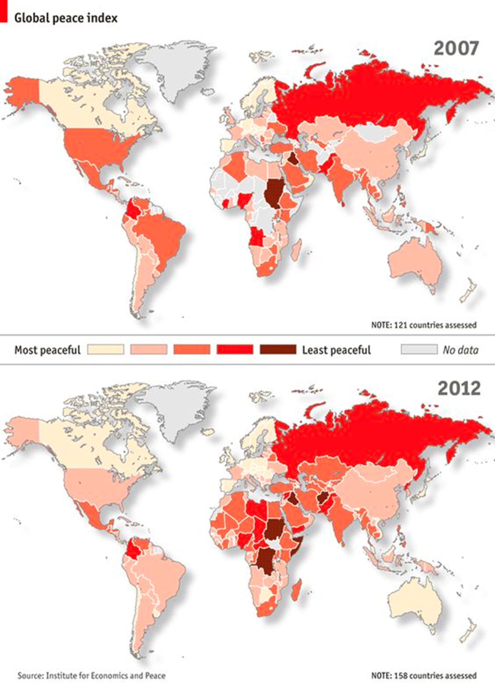
Why to learn Python?
Faculty of World Economy and International Affairs
Bachelor’s programme 'HSE and University of London Parallel Degree Programme in International Relations'
Data Analysis in Python. Seminar 1: Introduction
For everybody:
Programming really re-builds your mindset in more proper and consistent way
It is interesting!
For IR-student:
fruitful insights concealed in large databases: they are waiting for their hero(s)
you would probably resolve ‘Liberalism VS Realism problem’ (etc)
you need new data – you can easily collect it
lots of other advantages

Slide 8
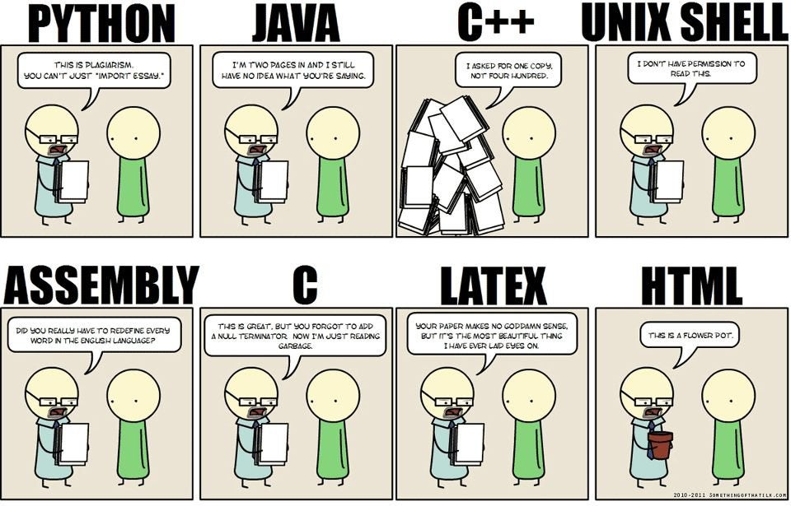
What is Python?
Faculty of World Economy and International Affairs
Bachelor’s programme 'HSE and University of London Parallel Degree Programme in International Relations'
Data Analysis in Python. Seminar 1: Introduction
Python is a programming language:
high-level
interpreted
general-purpose
dynamically-typed (you do not need to specify types explicitly)
garbage-collected (you do not need to worry about memory allocation)

Slide 9
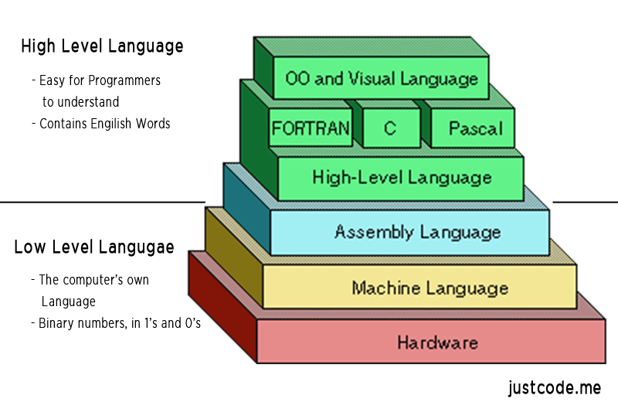
High-level
Faculty of World Economy and International Affairs
Bachelor’s programme 'HSE and University of London Parallel Degree Programme in International Relations'
Data Analysis in Python. Seminar 1: Introduction
human-understandable VS machine understandable

Slide 10
Interpreted
Faculty of World Economy and International Affairs
Bachelor’s programme 'HSE and University of London Parallel Degree Programme in International Relations'
Data Analysis in Python. Seminar 1: Introduction
Python commands
All processors (Intel, AMD and so on) have their own language (Machine code). It is very complicated
Python is simple for us, but complicated for computer
We should help computer to understand our commands
C language
Special binary programming language
Machine code

Slide 11



IDEs for Python
Faculty of World Economy and International Affairs
Bachelor’s programme 'HSE and University of London Parallel Degree Programme in International Relations'
Data Analysis in Python. Seminar 1: Introduction
We want to make our coding experience comfortable
We want to have special META-program that:
proceeds scary things like on previous slide
has interface for writing and editing code
helps us to code appropriately
provides with some other little joys
And we have such programs: IDEs (Integrated development environments)!
They are different for Python: Visual Studio Code, PyCharm, Jupyter Notebook (very interactive and appropriate for learning, Data Science and creativity)

Slide 12


Course prerequisites
Faculty of World Economy and International Affairs
Bachelor’s programme 'HSE and University of London Parallel Degree Programme in International Relations'
Data Analysis in Python. Seminar 1: Introduction
Python (I recommend 3.8 version)
Anaconda (can be downloaded here)

Slide 13
To-do list for the next week
Faculty of World Economy and International Affairs
Bachelor’s programme 'HSE and University of London Parallel Degree Programme in International Relations'
Data Analysis in Python. Seminar 1: Introduction
Join the Telegram Chat: https://t.me/+wbOQeYKqoc05NmJi
Install Python 3.8
Install Anaconda Navigator (and launch Jupiter Notebook):
Windows: https://www.youtube.com/watch?v=uOwCiZKj2rg
Mac OS: https://www.youtube.com/watch?v=iPsOCj_wKvY
Read the article “Computational International Relations: What Can Programming, Coding and Internet Research Do for the Discipline?”: https://arxiv.org/pdf/1803.00105.pdf

Slide 14

Thank you for your attention! Any questions?
Faculty of World Economy and International Affairs
Bachelor’s programme 'HSE and University of London Parallel Degree Programme in International Relations'
Data Analysis in Python. Seminar 1: Introduction

